Slide 1
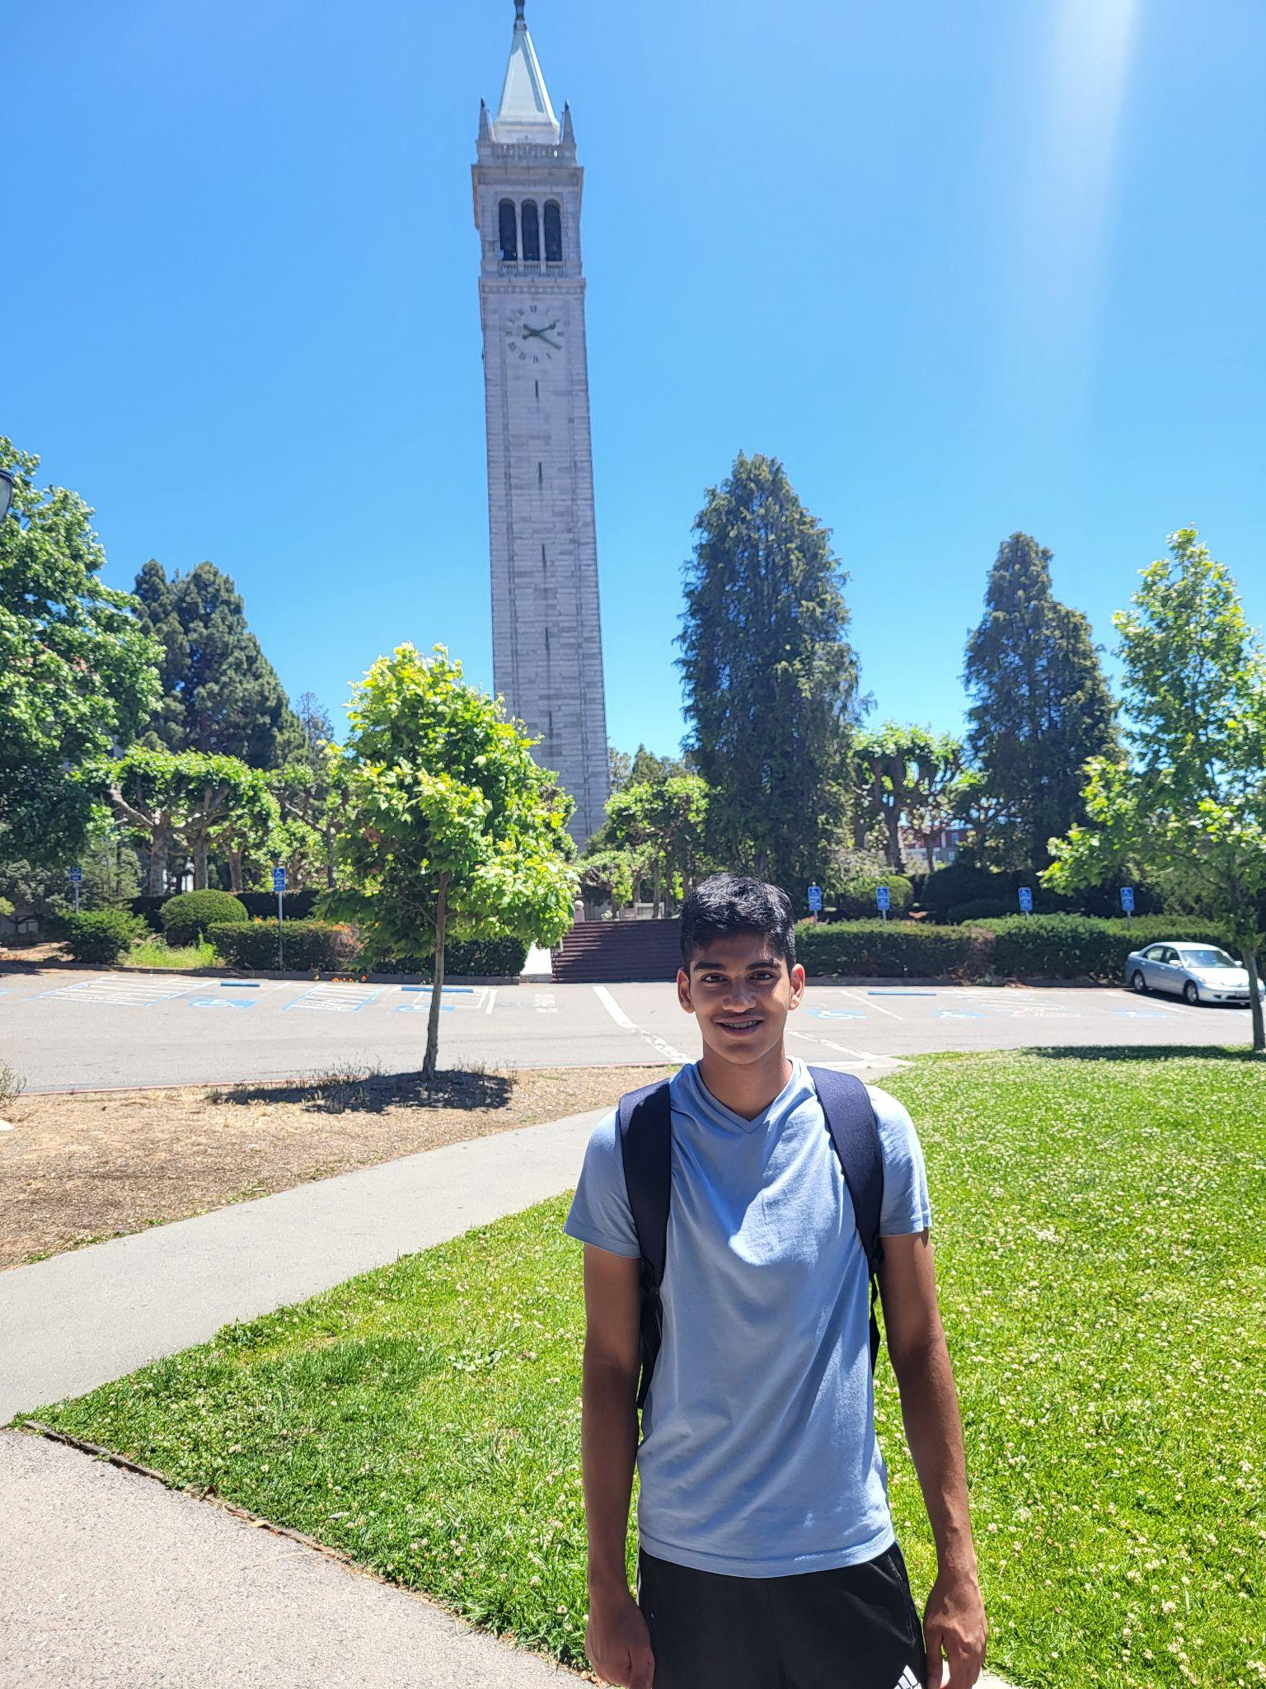
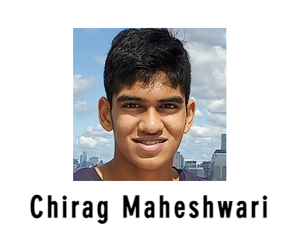
Introduction
I am a junior at Cypress Ridge High School
I have been interning at the Aiden Lab since 9th grade
I live in Houston and have been here my whole life
I am really interested in math and computer science, especially machine learning
I also love to play basketball and played for my school last year
I became an Atlas Fellow in June

Slide 2
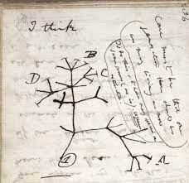
Basics: Phylogenetic trees
Phylogenetic trees are family trees between different species of animals. They tell us the path evolution took by showing how closely or distantly different species are related.

Slide 3
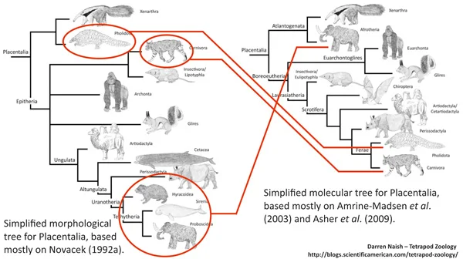
Basics: Phylogenetic characters
Any feature of a species that is common in other similar species can serve as a phylogenetic character.

Slide 4
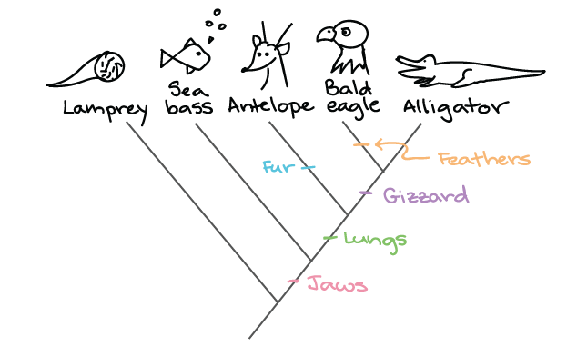
Constructing a phylogenetic tree: Morphology
Morphology looks at the form and structure of an organism to reconstruct phylogenies. However, this form of reconstruction is not very accurate.

Slide 5
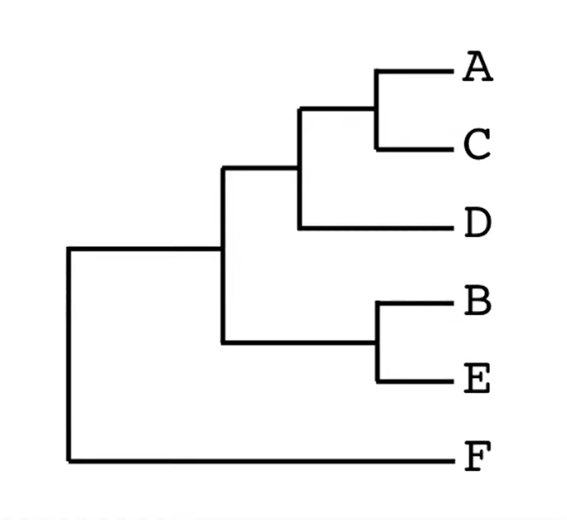
Constructing a phylogenetic tree: DNA Bases
A ATCGTGGTACTGT
B CCGGAGAACTAGT
C AACGTGCTACTGA
D ATGGTGAAAGTGT
E CCGGAAAACTTGT
F TGGCCCTGTATCA
Phylogenies can also be reconstructed through the large number of DNA Bases in an organism’s genome.
However, there are only four possible mutations for a DNA Base. So, the species’ close and distant family cannot be accurately determined.
A
T
A
Notes:
Under the assumption that the mutation is random - Done
Highlight sequence of relevance - Done
Show some base which is accidentally the same - Done
Same for A, D, B, E different in C, F - Done

Slide 6
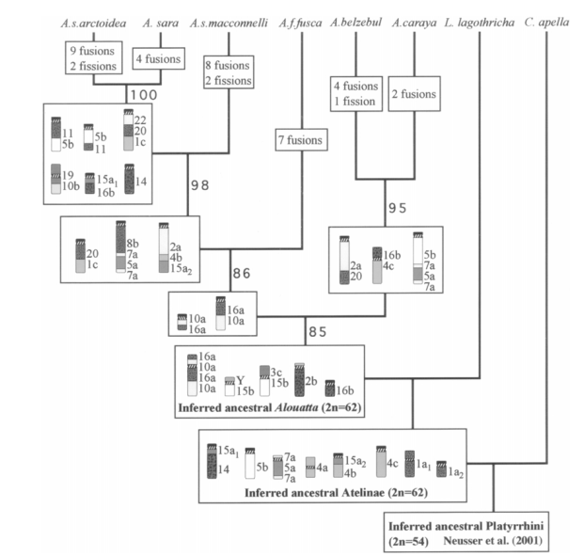
Chromosomal rearrangements as phylogenetic characters
Assuming breaks are random, The chance that two species evolved separately and have the same break is 1 out of 3,000,000,000, much smaller than the 1 out of 4 chance of two DNA Bases being the same.
Notes:
Much larger variation space than DNA Bases - Done
Some areas might be more prone to breaking than others - Done
Under the assumption that the break is random - Done
Less text - Done
¼ vs ⅓ billion - Done
Break into two slides - Use rearrangements as phylogenetic characters
Good visual language to represent data

Slide 7
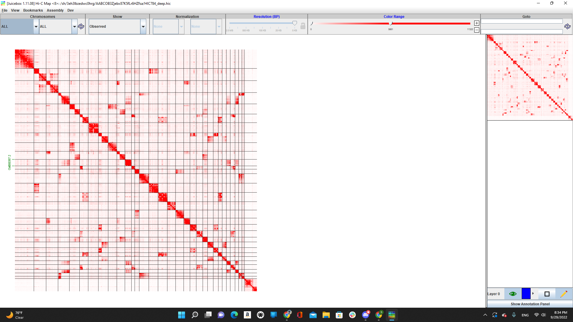
Chromosomal rearrangements as phylogenetic characters
Visualizing HiC data is the Aidenlab’s “bread and butter.”
All features of the data are shown very clearly.
Notes:
Show typical characters

Slide 8
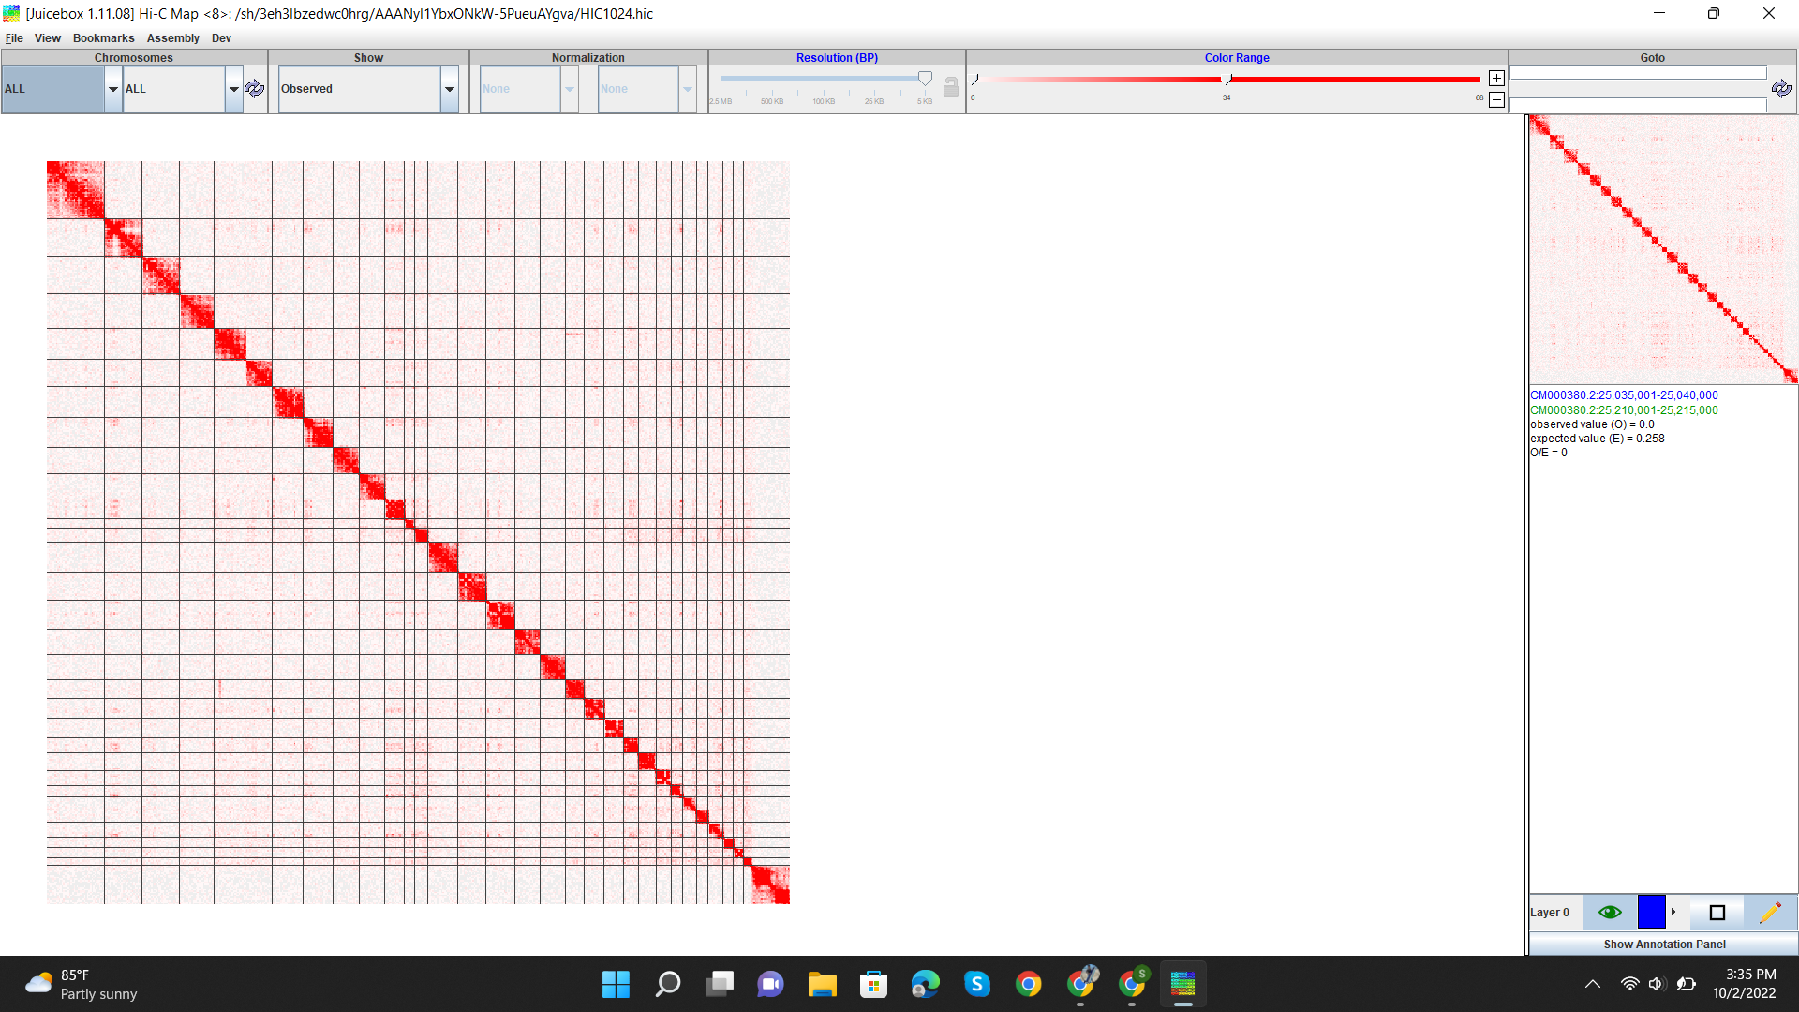
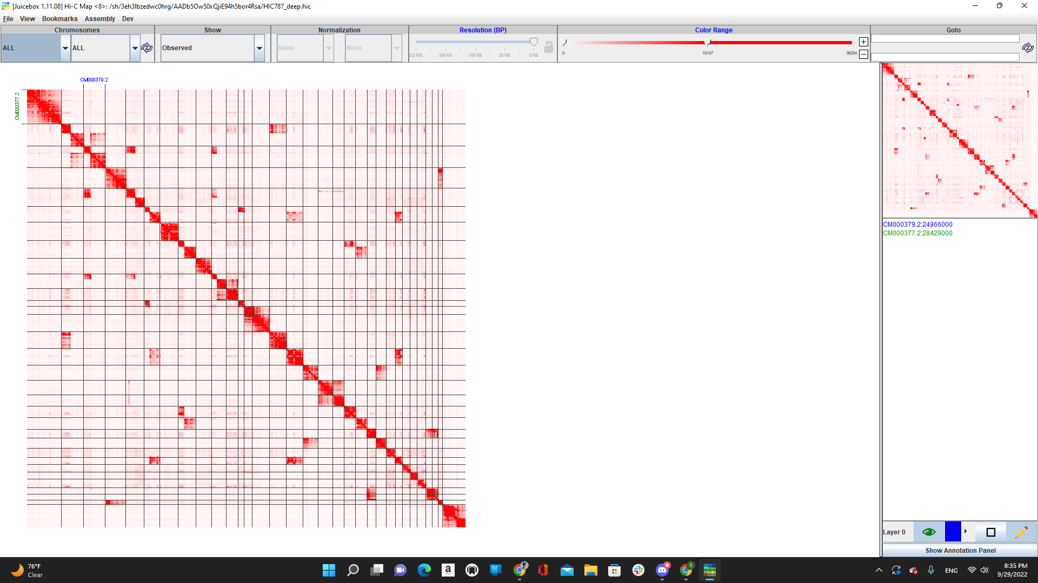
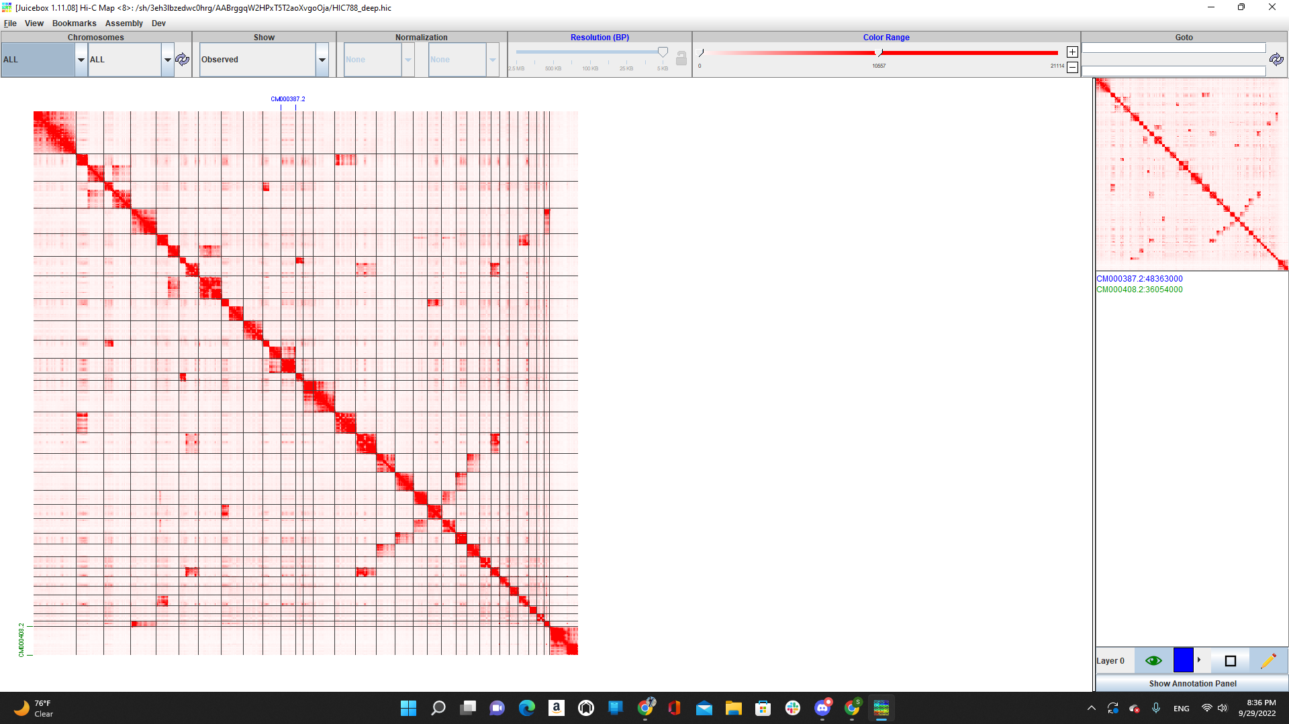
Example: Horse and 3 Zebras
Mountain Zebra Zakota
Grant’s Zebra Zena
Grant’s Zebra Zoatira
Horse

Slide 9
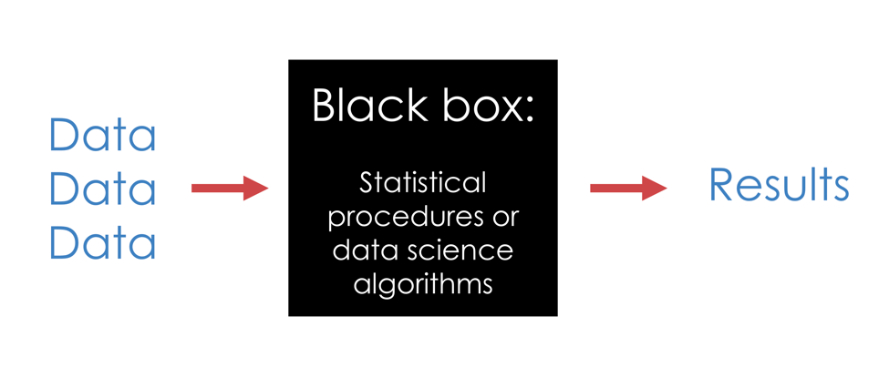
ML: Efficient way to approach such problems
Notes:
Transition slide to ML (no text) - Done
Abstract figure to represent ML - Done
ML is a blackbox - Done
Statistical analysis tool - Done
Computer vision
Look for better image

Slide 10
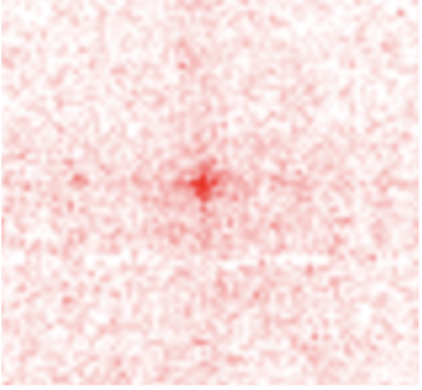
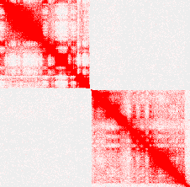
We are not the first ones in the lab to use ML
Notes:
Loops image (is at 5 kb and is 55 by 55) - Done
Break Image (same style as loop image) - Done
Minimize differences in image - Done

Slide 11
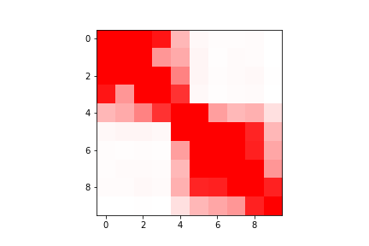
Details: Task formulation
For a given NxN symmetric contact matrix, the classifier should answer, what’s the probability that the underlying genomic sequence is “broken” somewhere within the central bin.
?
Notes:
Animation for the central bin - Done
Use same images as much as possible - Done

Slide 12
Task: Is there a break in the middle?
?
Notes:
Animation for the central bin - Done
Use same images as much as possible - Done

Slide 13
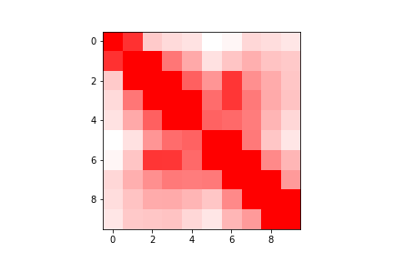
Two birds with one classifier
Fusion = ! Break
Part I: Detect breaks
Part II: Detect fusions that result from those breaks
Since a break is just a lack of a fusion, the same model can detect breaks and fusions.

Slide 14
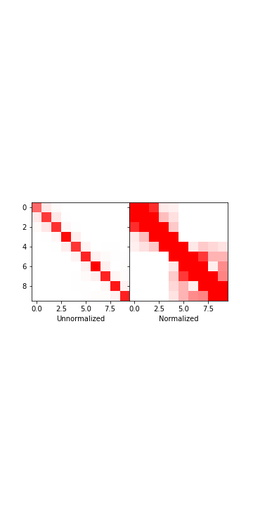
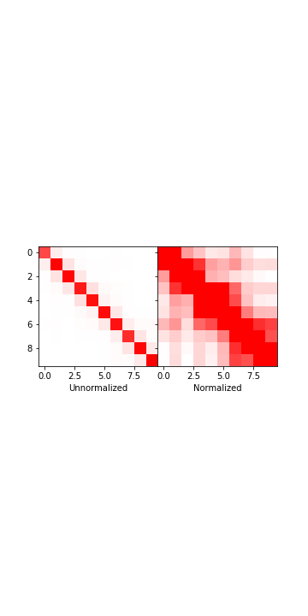
Preprocessing
Cap data at the 95th percentile, like in Juicebox.
Then, the data is linearly scaled between 0 and 1.
Preprocessing the data before feeding it to the model is key because we already know the best way to manipulate the data, and so the model does not need to figure it out itself.
Notes:
Discuss advantages of normalizing manually rather than having the model do it
Merge Normalization visualization with this slide - Done

Slide 15

Details: Layers
Dense
Dropout
Dense
Dense
Dropout
Dense
Feature generator, detector, and extractor
Prevents Overfitting
Feature generator, detector, and extractor
Notes:
TF can output a small visualization of the model - Not working
Keep only relevant functions - Done
Describe the functions that are kept - Done
Add dropout layer image - Done
Remove preprocessing from layers section - Done
Dense layer - hidden layer, turns the input into something the output layer can take in.
Feature generator, detector, and extractor
Generic
The more dense layers, the more complex the function
Slightly more complex than edge detector
Better image more specific to the model - Done

Slide 16
Details: Layers
Notes:
TF can output a small visualization of the model - Not working
Keep only relevant functions - Done
Describe the functions that are kept - Done
Add dropout layer image - Done
Remove preprocessing from layers section - Done
Dense layer - hidden layer, turns the input into something the output layer can take in.
Feature generator, detector, and extractor
Generic
The more dense layers, the more complex the function
Slightly more complex than edge detector
Better image more specific to the model - Done

Slide 17
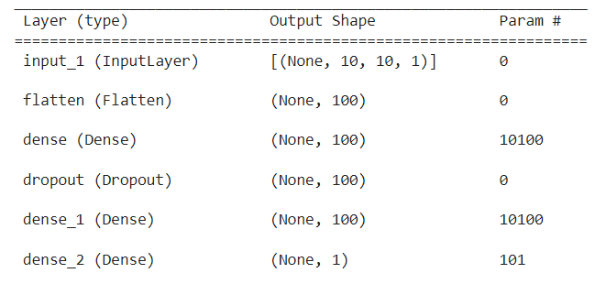
Details of the model - Model Structure

Slide 18
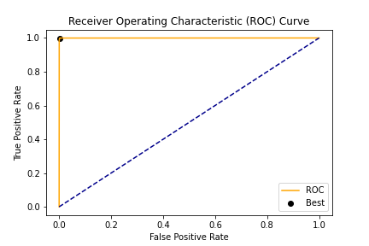
Details: Training
Confusion Matrix:
True Negative: 5807 | False Positive: 97
False Negative: 0 | True Positive: 4096
Training File: Cricetulus_griseus_HiC.hic
Loss function: Binary Cross Entropy
Resolution: 1 MB
Matrix Size: 10 x 10
Notes:
Add ROC Curve - Done

Slide 19
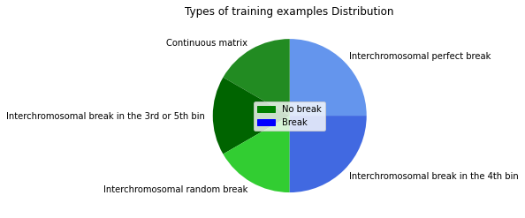
Details: Training
Notes:
Highlight inter vs intra

Slide 20
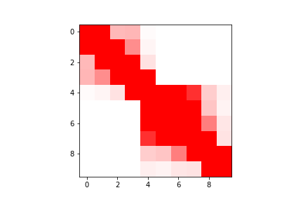
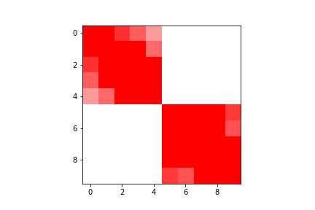
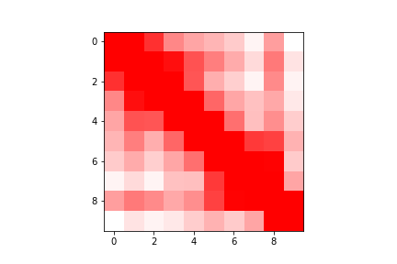
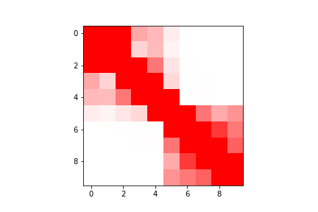
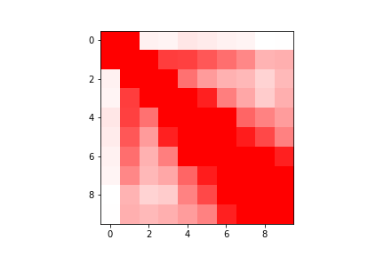
Break in the 4th Bin
Perfect Break
Continuous Matrix
Break in 3rd or 5th Bin
Random Break

Slide 21
Types of Training Data: Break in the 4th Bin
Purpose:
Show the model exactly what to predict
How it is created:
Choose a partition point (p) in the range [40, 49] randomly.
Randomly choose 2 chromosomes and randomly choose a matrix of size p from one chromosome and size 100-p from the other at a resolution of 100kb.
Stitch these matrices together.
Downsample the 100 by 100 matrix to a 10 by 10 matrix.
Notes:
Merge all training data slides - Done

Slide 22
Types of Training Data: Perfect Breaks
Purpose:
Show the model a very specific example of what to predict that it often failed on
How it is created:
Randomly choose 2 chromosomes and randomly choose a matrix of size 5 from each chromosome at a resolution of 1mb.
Stitch these matrices together.

Slide 23
Types of Training Data: Continuous Matrix
Purpose:
Show the model exactly what not to predict
How it is created:
Randomly choose a chromosome and randomly choose a matrix of size 10 at resolution of 1mb.

Slide 24
Types of Training Data: Break in 3rd or 5th Bin
Purpose:
Show the model a very specific example of what not to predict that it often failed on
How it is created:
Choose a partition point (p) in the range [30, 39] U [50, 49] randomly.
Randomly choose 2 chromosomes and randomly choose a matrix of size p from one chromosome and size 100-p from the other at a resolution of 100kb.
Stitch these matrices together.
Downsample the 100 by 100 matrix to a 10 by 10 matrix.

Slide 25
Types of Training Data: Random Break
Purpose:
Show the model to only predict breaks in the 4th bin.
How it is created:
Choose a partition point (p) in the range [1, 99] randomly.
Randomly choose 2 chromosomes and randomly choose a matrix of size p from one chromosome and size 100-p from the other at a resolution of 100kb.
Stitch these matrices together.
Downsample the 100 by 100 matrix to a 10 by 10 matrix.

Slide 26
Workflow
Align all species to the same reference and build contact maps
For each map, examine every bin along the diagonal (and it’s 10x10 neighborhood) to see if it represents a break
Merge breaks from across all species and (optional) reexamine probabilities to address low confidence cases
For all breaks and existing chromosome ends, check if chimeric matrix suggests a fusion
[TODO] Filter annotated fusion events so that they are not mutually exclusive
Analyze the resulting rearrangement character matrix

Slide 27
Step 1: align all species
Mountain Zebra Zakota
Grant’s Zebra Zena
Grevy’s Zebra Zoatira
Horse

Slide 28
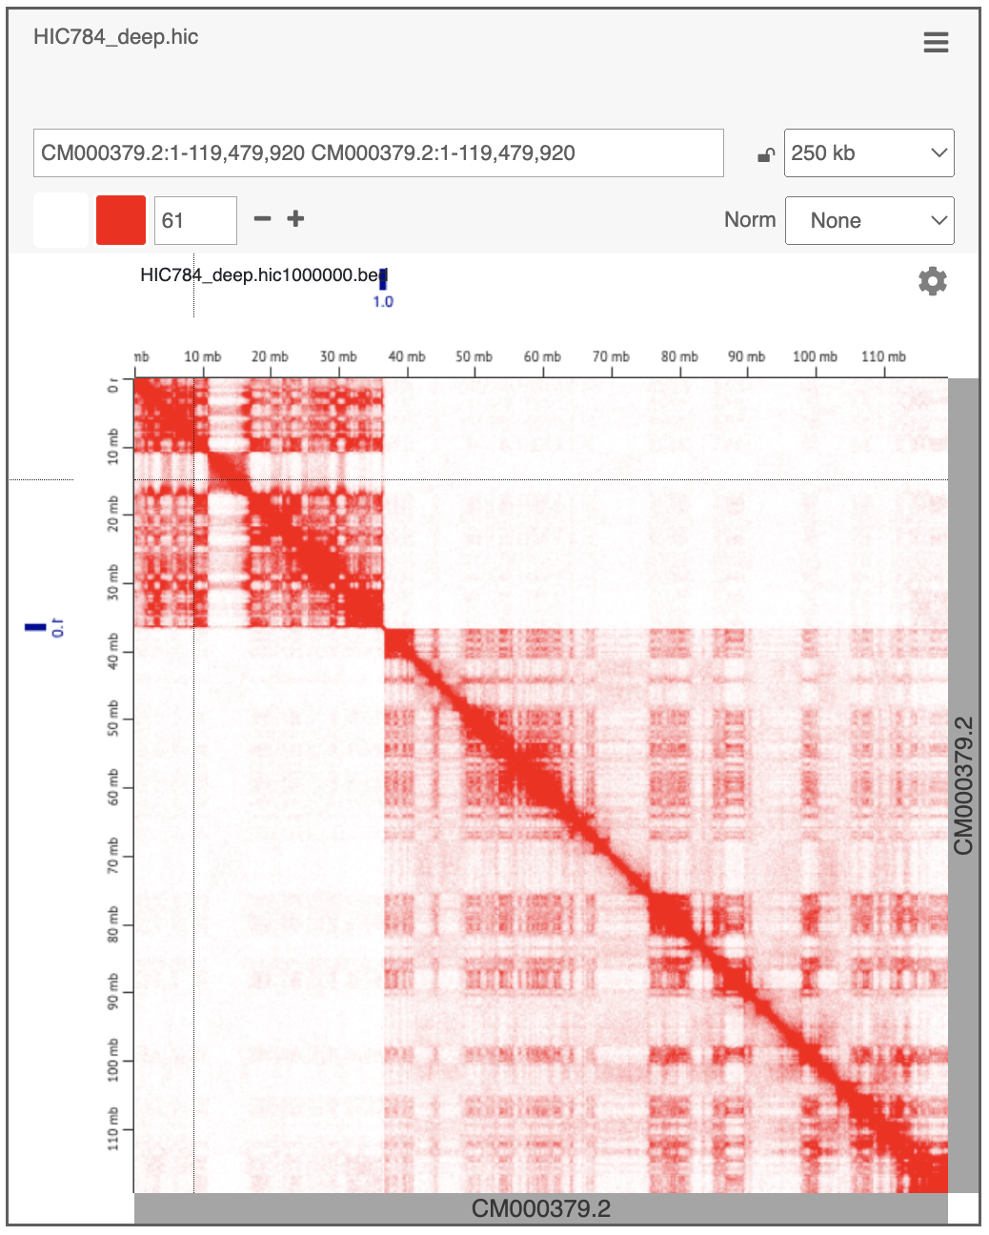
Step 2: detect breaks
Mountain Zebra, PBMC, rep 1 (HIC784) - https://tinyurl.com/2zyelpo7
Mountain Zebra, PBMC, rep 2 (HIC785) - https://tinyurl.com/2ggb9ndm
Grant’s Zebra, PBMC (HIC787) - https://tinyurl.com/2dsfp2de
Grevy’s Zebra, PBMC (HIC788) - https://tinyurl.com/2j94h49g
Grant’s Zebra, fibroblast (HIC961) - https://tinyurl.com/2otrryhh
Donkey, PBMC, rep 1 (HIC1026) - https://tinyurl.com/2lcph6l8
Donkey, PBMC, rep 2 (HIC1074) - https://tinyurl.com/2er7h6sb
(it isn’t perfect)
Notes:
Screenshot/QR Code to break annotations on Juicebox - Done
All of them - Done
Step 1 - Contact matrices that are aligned - Done
Follow the Workflow steps - Done

Slide 29
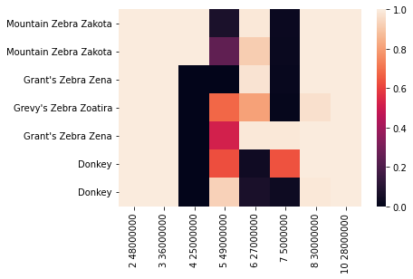
Step 3: Create break matrix & reexamine breaks
Break probability
Break position (chr coordinate)
Notes:
Remove hic labels - replace them with species - Done
Create break matrix and reexamine breaks - Done

Slide 30
Step 4: detect fusions
a b c d
b a c d

Slide 31
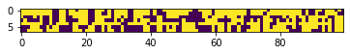
Step 5: create fusion* character matrix
Note 1: This is a fragment of the matrix.
Note 2: For now, these characters do not indicate a fusion event but rather residence on the same molecule.
Notes:
Add binary image of character matrix - Done
An end can be fused to multiple ends - sees if it is in the same chromosome not if it is fused

Slide 32
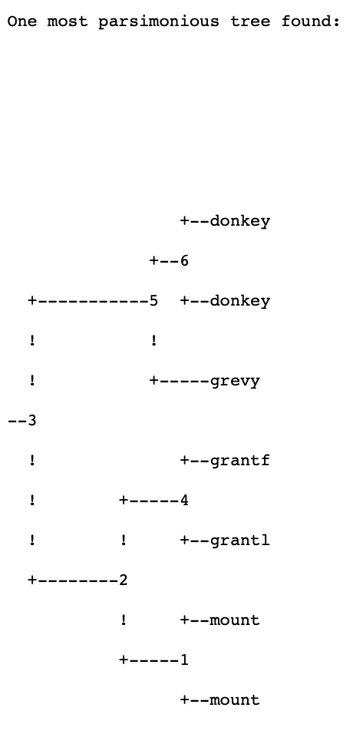
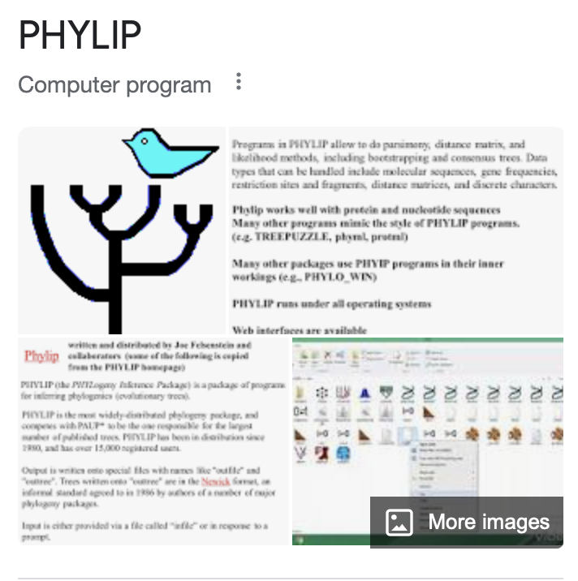


Step 6: Phylogenetic character analysis
Notes:
grandf-961
grand and grandl come from two different cell lines
phylogeny-finale

Slide 33
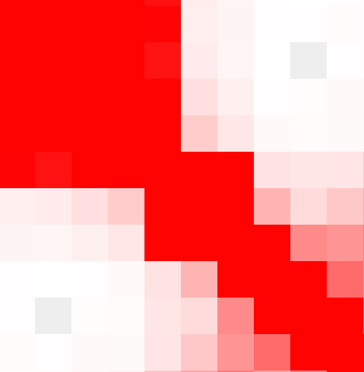
Future Work
Less false positives, less false negatives!
Incorporate multiple color scales and maybe resolutions?
Filter annotated fusion events so that they are not mutually exclusive
Identify intrachromosomal breaks

Slide 34
Future work: cleaning the fusion matrix
The fusion matrix is populated with too many columns that contain incorrect/irrelevant data. For example, the current fusion matrix suggests that a segment can be fused to multiple other segments.
To clean the fusion matrix, the following steps can be taken:
Improve the model
Create an algorithm that takes the probabilities of the fusion matrix and returns a matrix with every segment in the matrix fused to only one other segment in the matrix.

Slide 35
Future work: intrachromosomal breaks
There is more noise around an interchromosomal break than an interchromosomal break.
To identify these breaks, the following steps can be taken:
Train the model on 3 different centiles
Train the model on intrachromosomal training data
Notes:
Add summary slide with future work

